Slide 1

Bank Marketing Project
By Alyssa Hubiak and Nasibul Hossain

Slide 2
Project Plan
Project Goal: Develop a model to predict whether a customer is likely to buy the bank's product or not. This will help ABC Bank determine where to focus their marketing for their new term deposit product. This will need to be a binary classification model to predict whether the customer will subscribe (1) or not (0).
The project will be broken down into several steps:
Initialization
Data Understanding and Preparation
Exploratory Data Analysis
Model Building and Selection
Conclusion and Final Recommendations

Slide 3
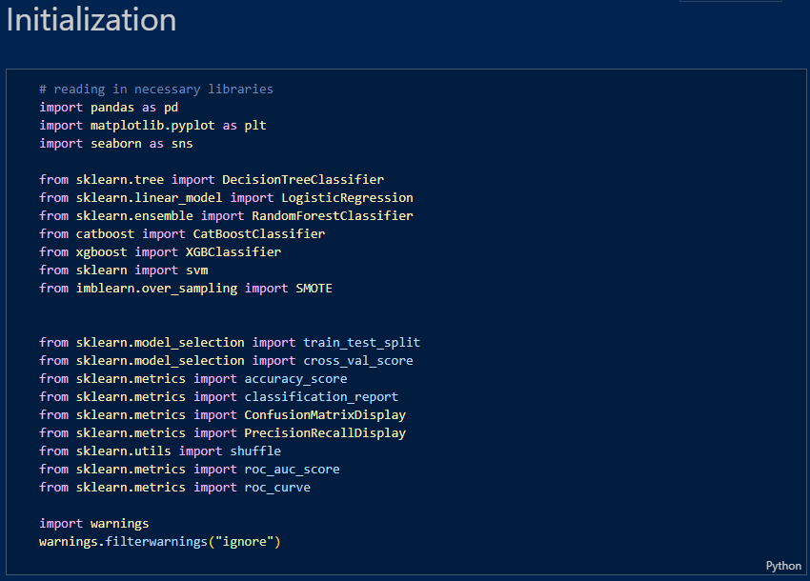

Slide 4
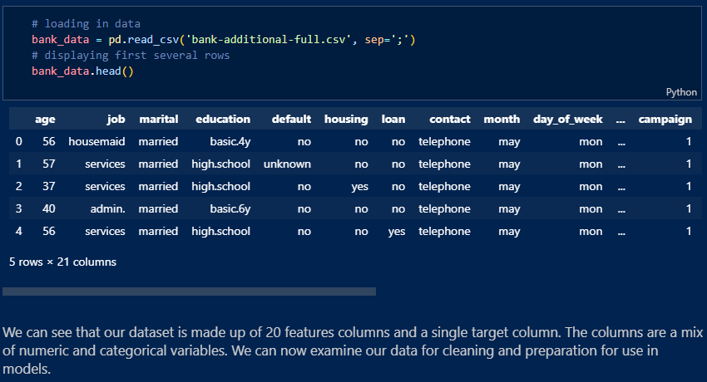

Slide 5
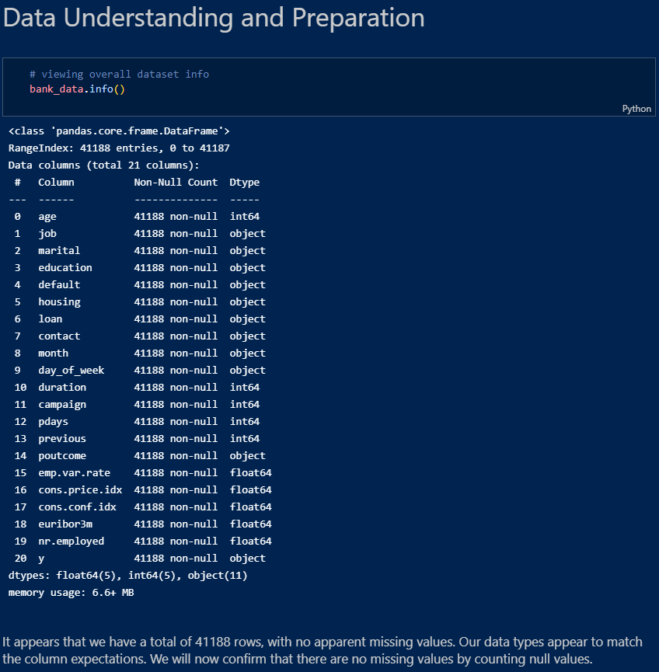

Slide 6
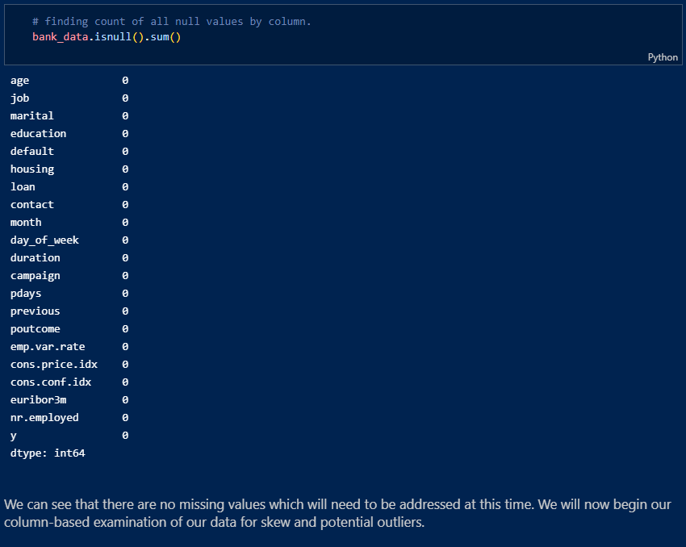

Slide 7
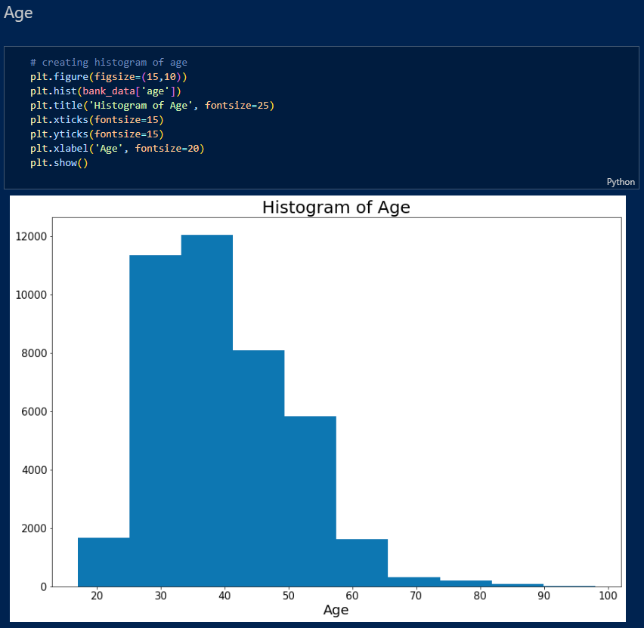

Slide 8
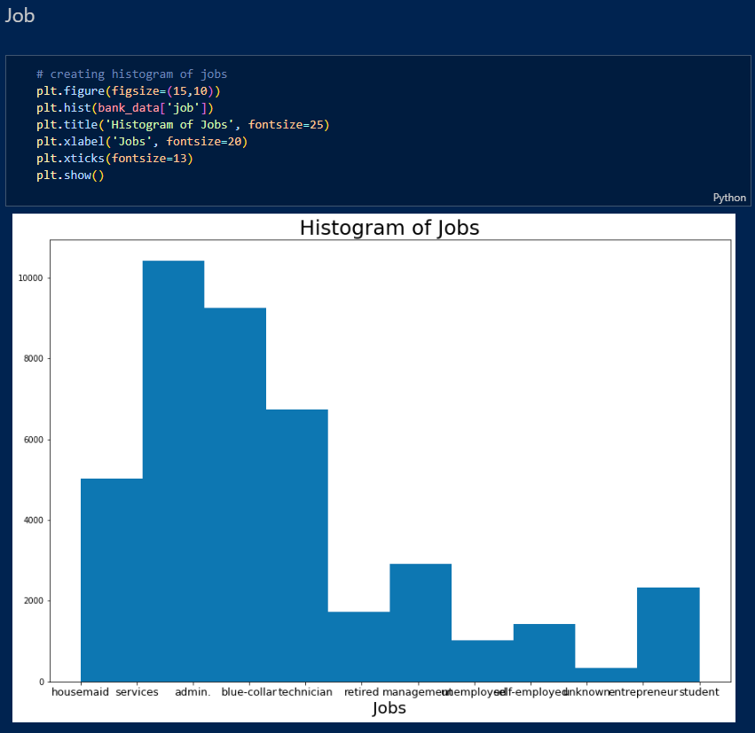

Slide 9
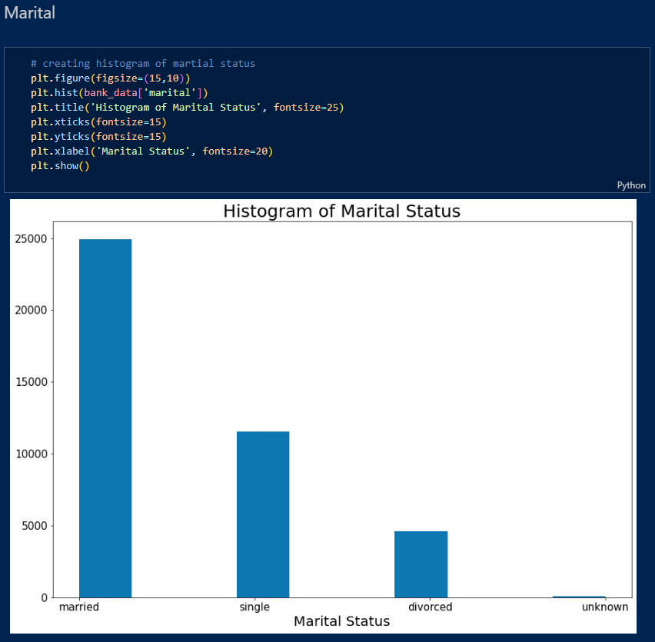

Slide 10
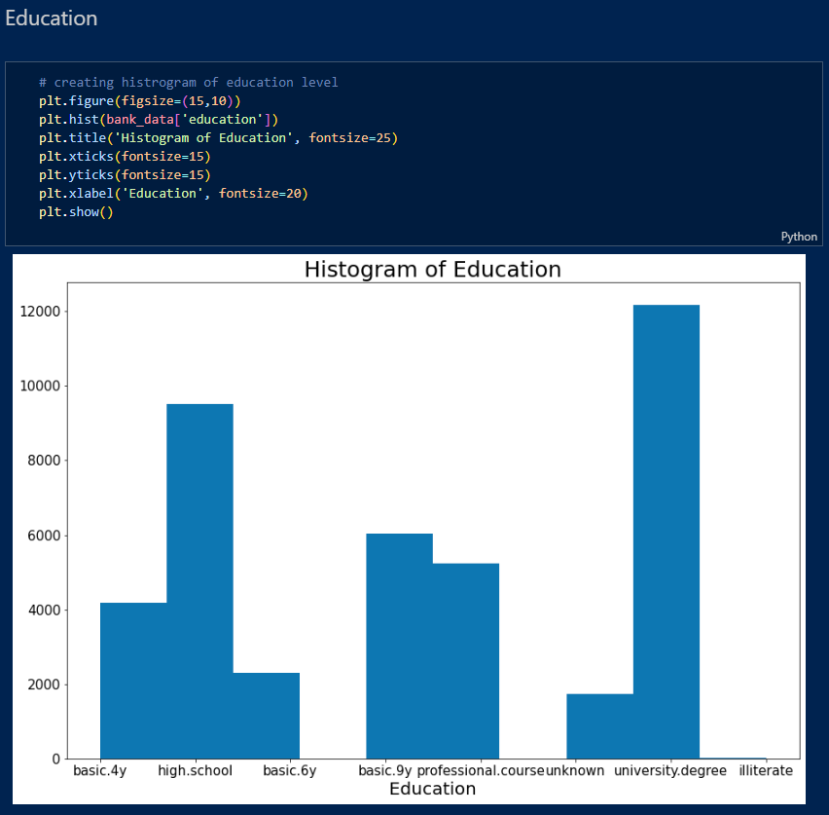

Slide 11
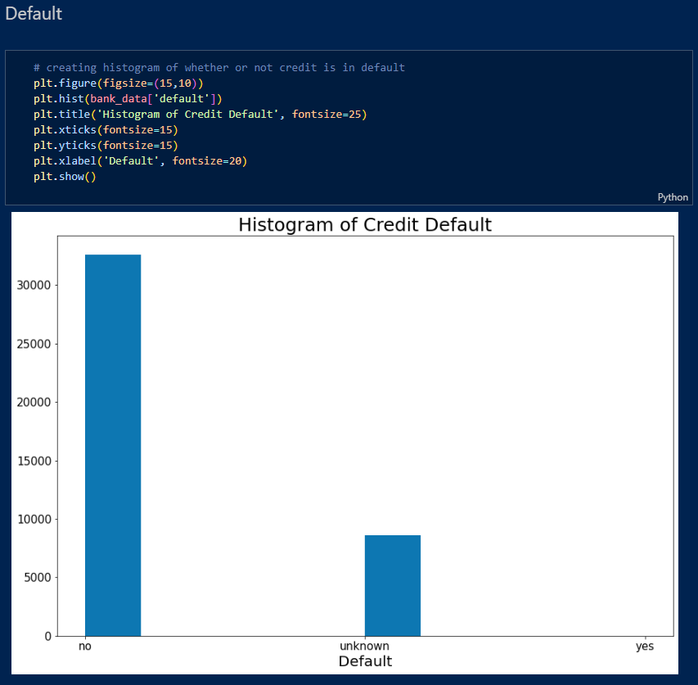

Slide 12
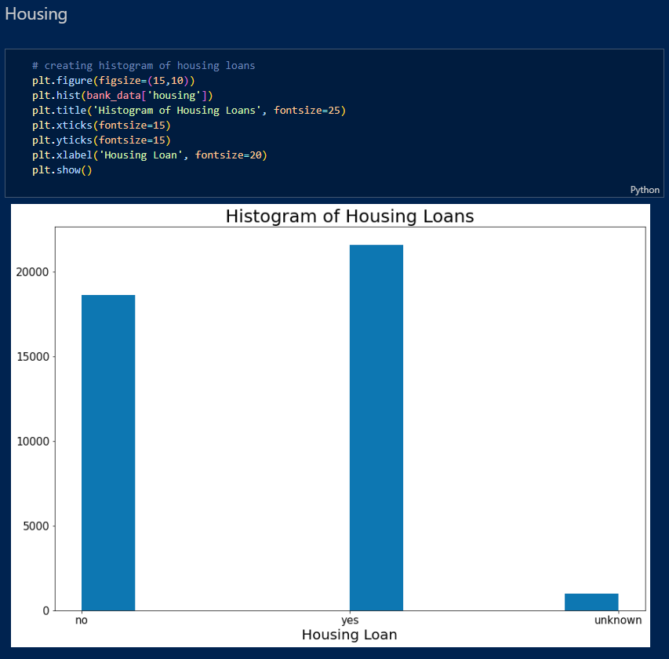

Slide 13
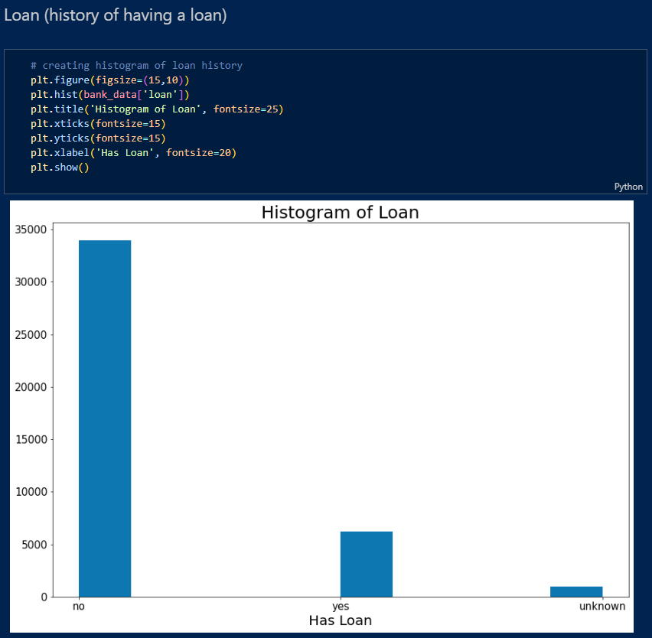

Slide 14
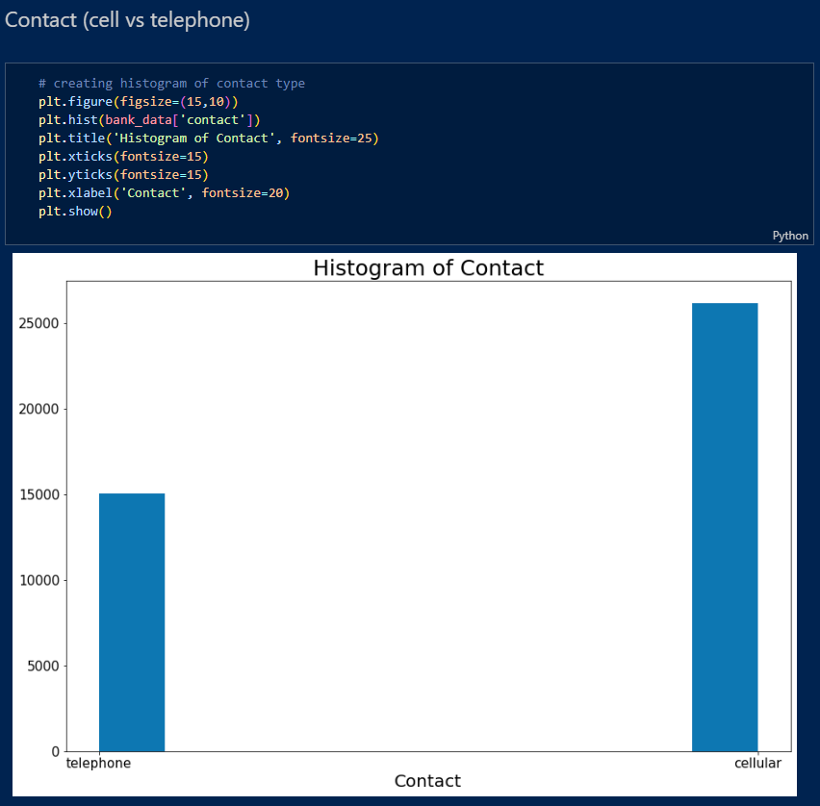

Slide 15
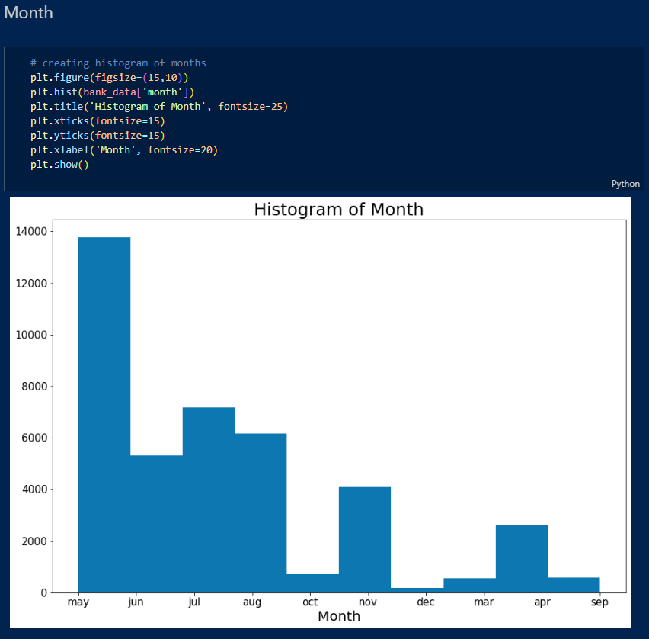

Slide 16
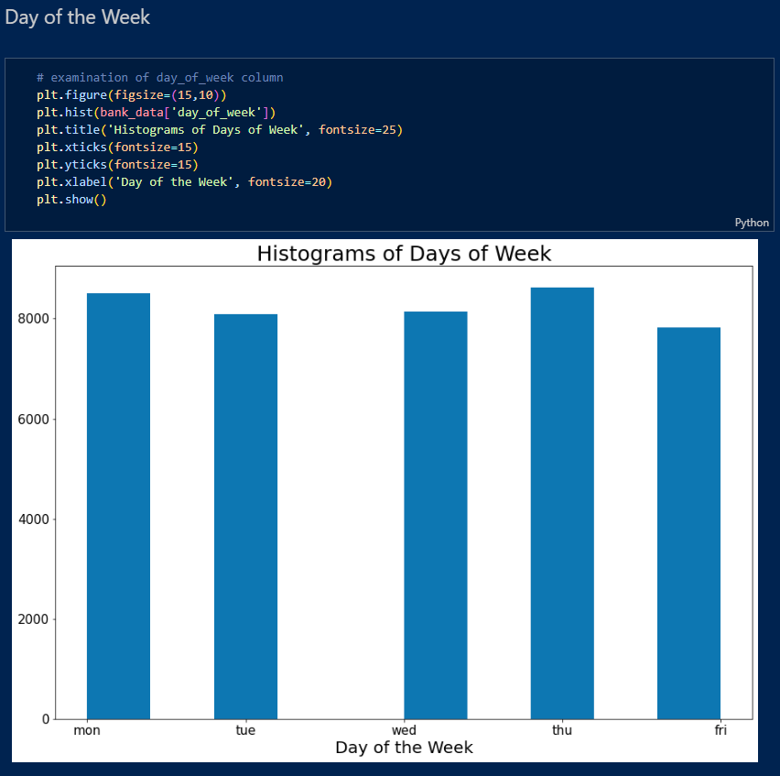

Slide 17
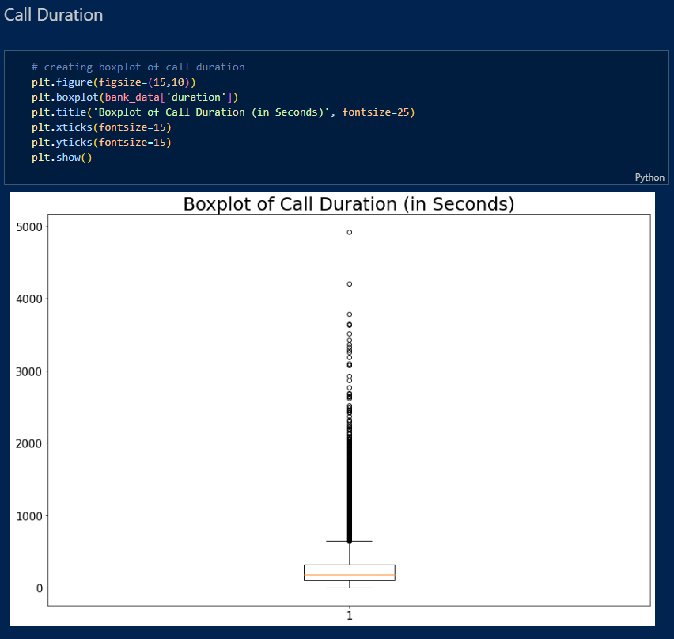

Slide 18
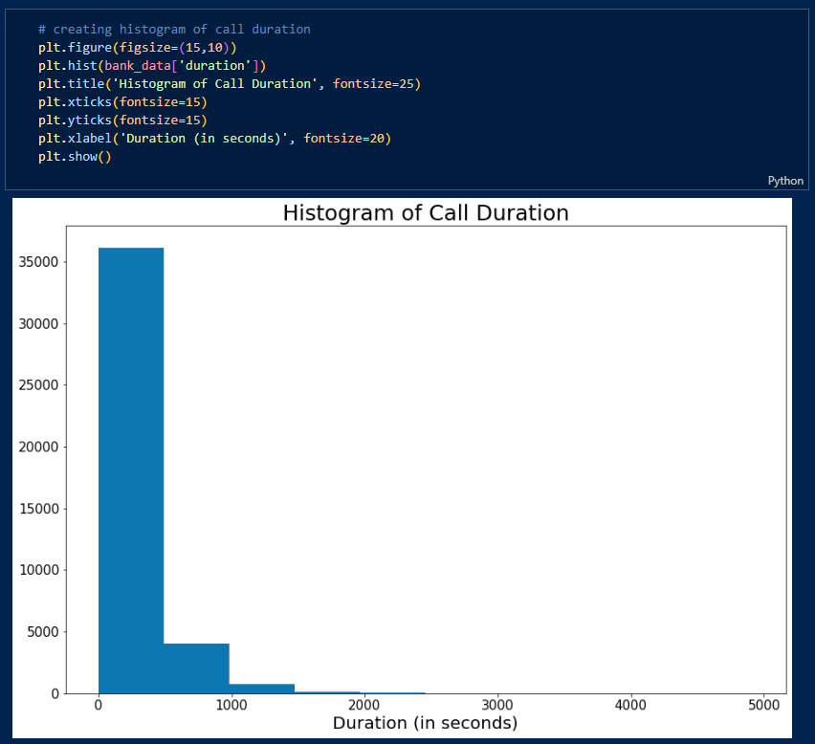
There are a significant number of outliers related to this column and it is right skewed. This is likely due to the majority of calls resulting in no term deposit subscription being close to zero, bringing down the average call time. This would typically need to be addressed prior to model creation, but due to the fact this variable is not known until after the call is completed, it will not be helpful in creating a accurate predictive model. Therefore, this feature will be dropped from the dataset after exploration prior to model creation.

Slide 19
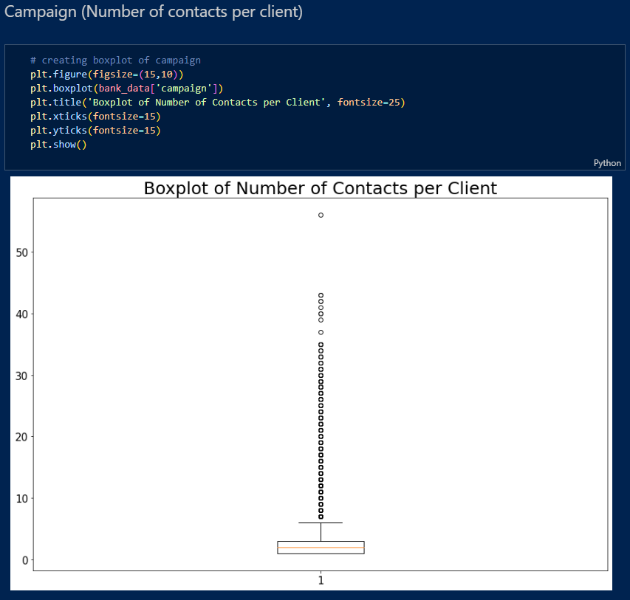

Slide 20
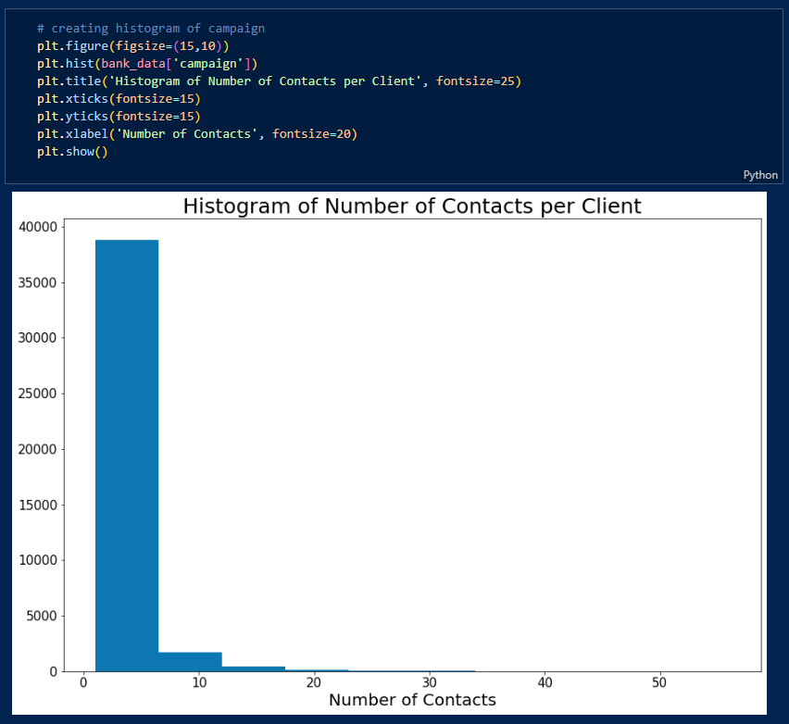
We can see a similar issue, with large numbers of outliers and right-skewed data. It can be assumed that since this is likely due to the majority of customers being relatively new, since the values are a count of every time the client has been contacted. It may be worth further exploration into length of time a client has been with the company to see if this has a greater effect on our predictions.

Slide 21
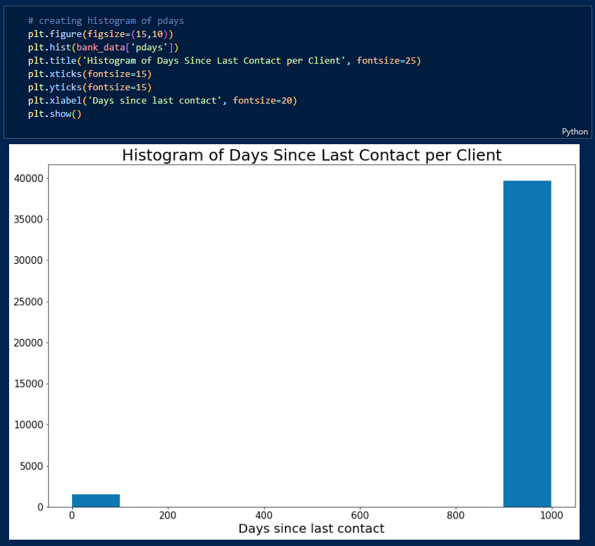
It is important to note that a client which has not been contacted previously will have a pday value of 999. This will make it difficult to interpret a boxplot due to the large spread. Therefore, a histogram will be utilized to better examine the data. As expected, the majority of clients fall into the category of never being contacted, and thus have a value of 999. We will take a closer look at those who have been contacted previously by adjusting our limits.

Slide 22
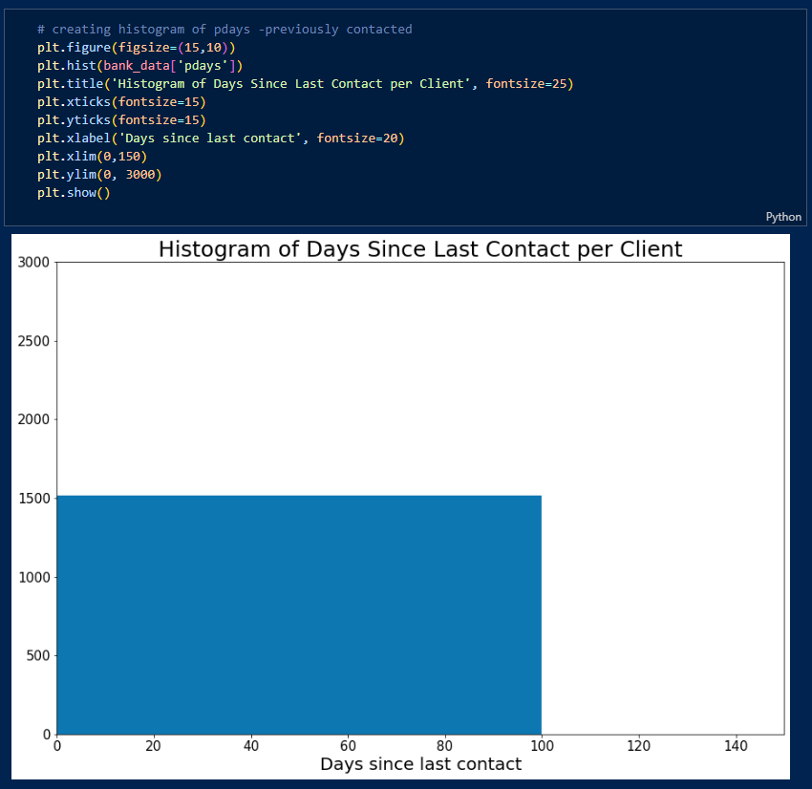
It appears that all the customers that have been contacted fall within the previous 100 days.

Slide 23
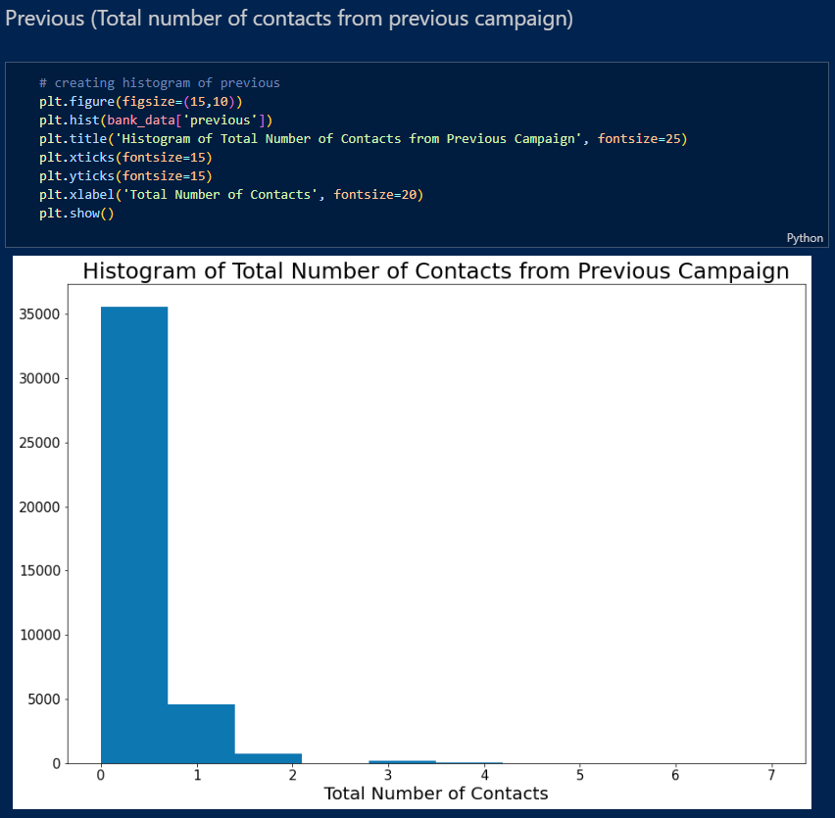
As expected, based on our previous column, there are a large number of clients who have never been contacted prior, resulting in a right-skewed data set.

Slide 24
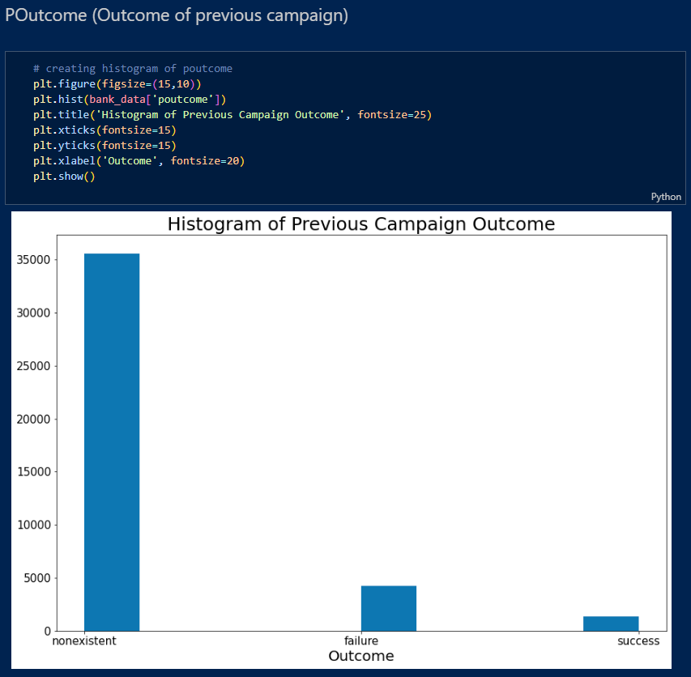

Slide 25
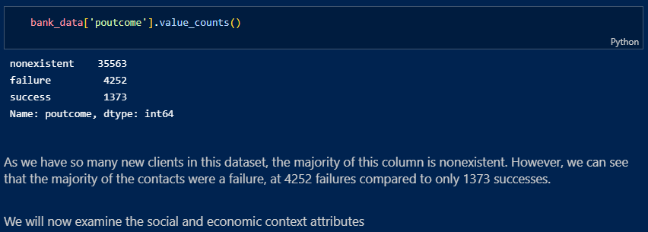

Slide 26
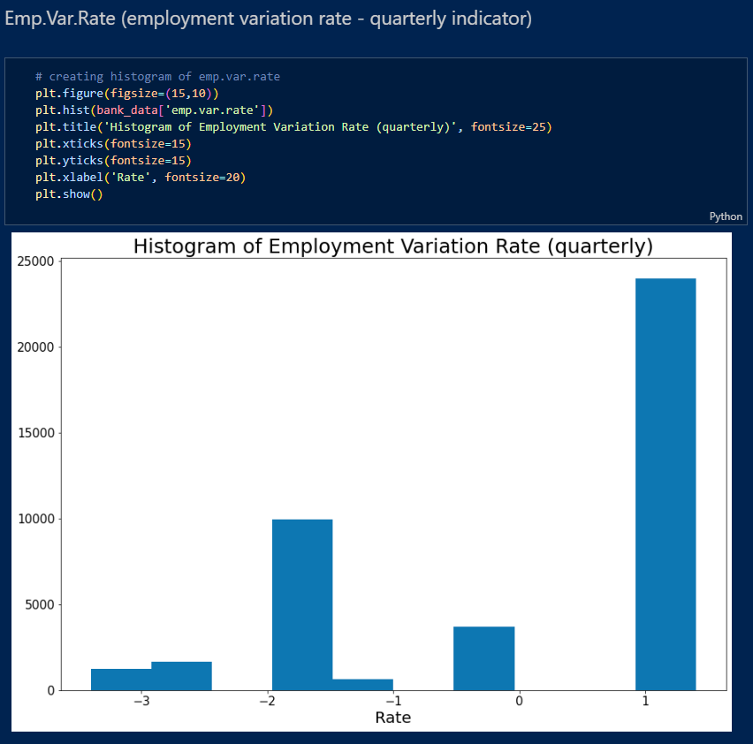

Slide 27
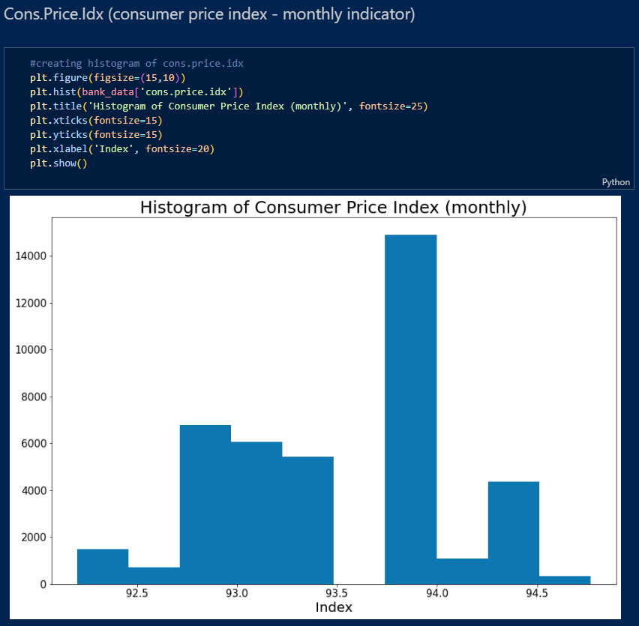

Slide 28
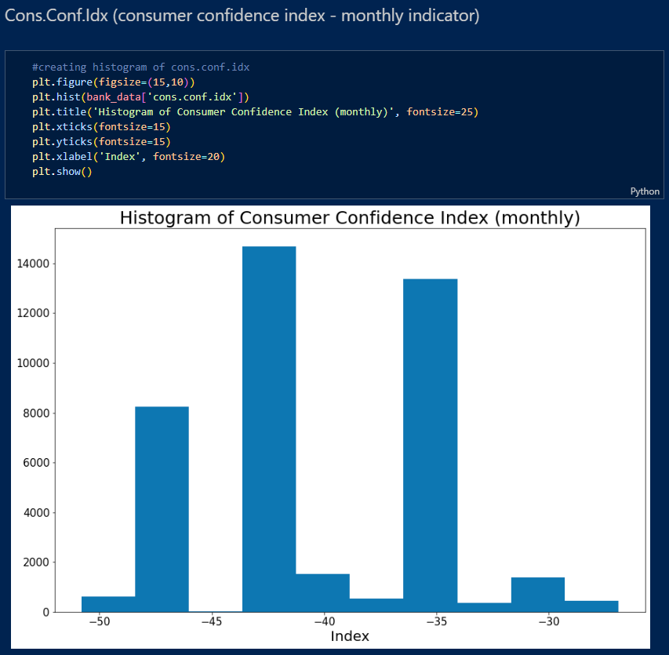

Slide 29
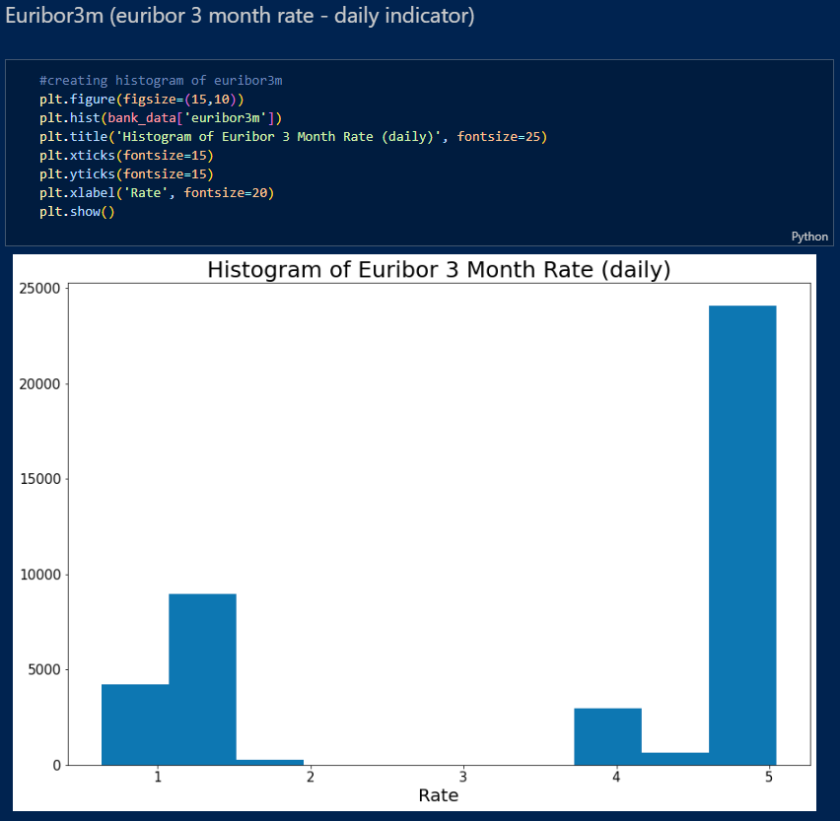

Slide 30
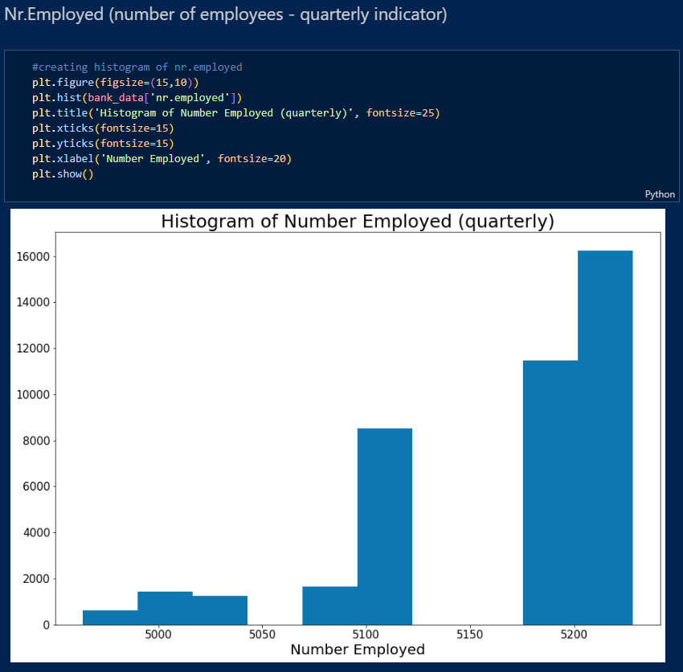
Overall, all of our social and economic data shows no significant evidence for skew or outliers which will need to be addressed.

Slide 31
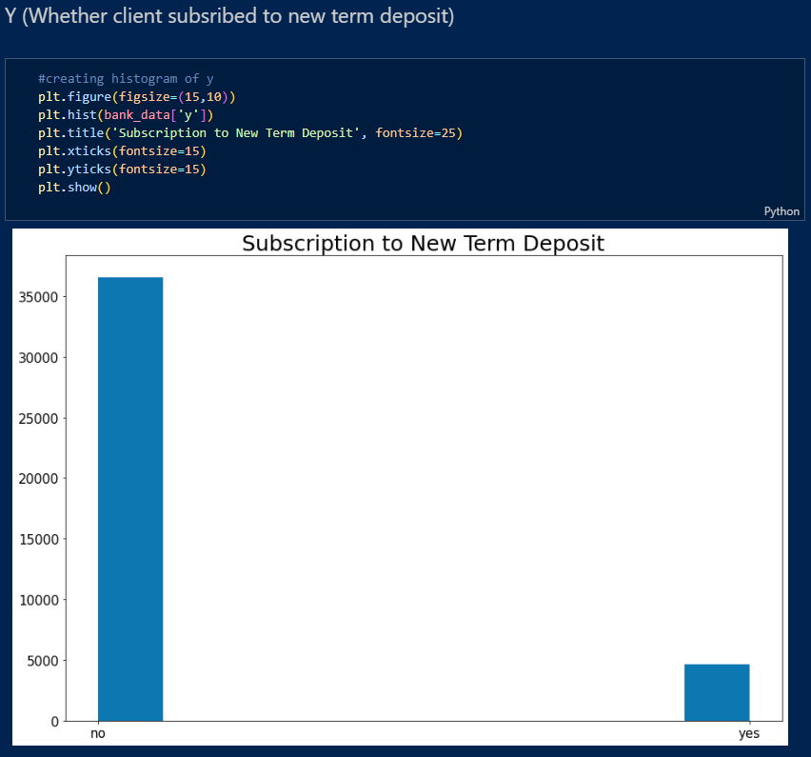

Slide 32
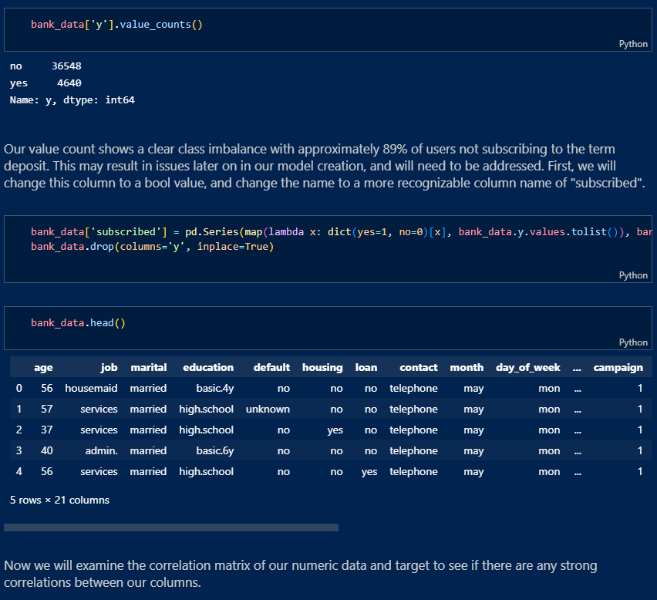

Slide 33
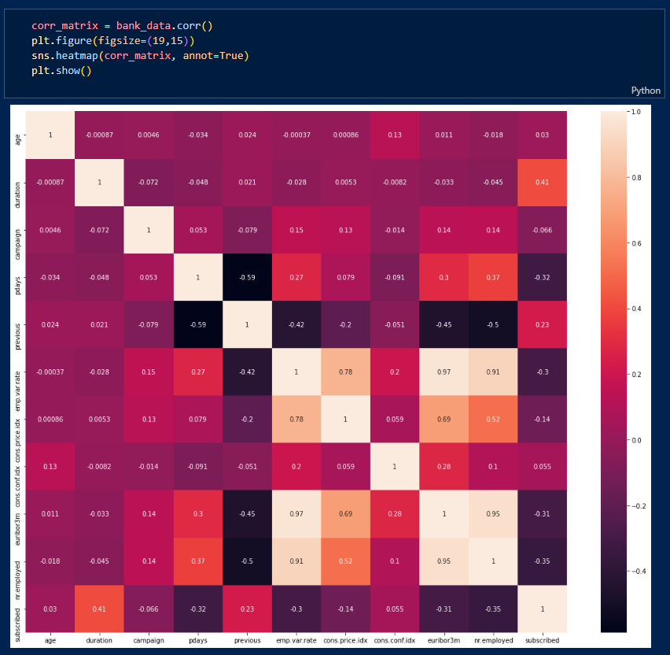
We can see that there is no significant correlation between any of our columns and our target. We can see that there is significant correlation between our economic variables, which is to be expected as they are all based on current economic trends. We will also examine a scatter matrix of this data.

Slide 34
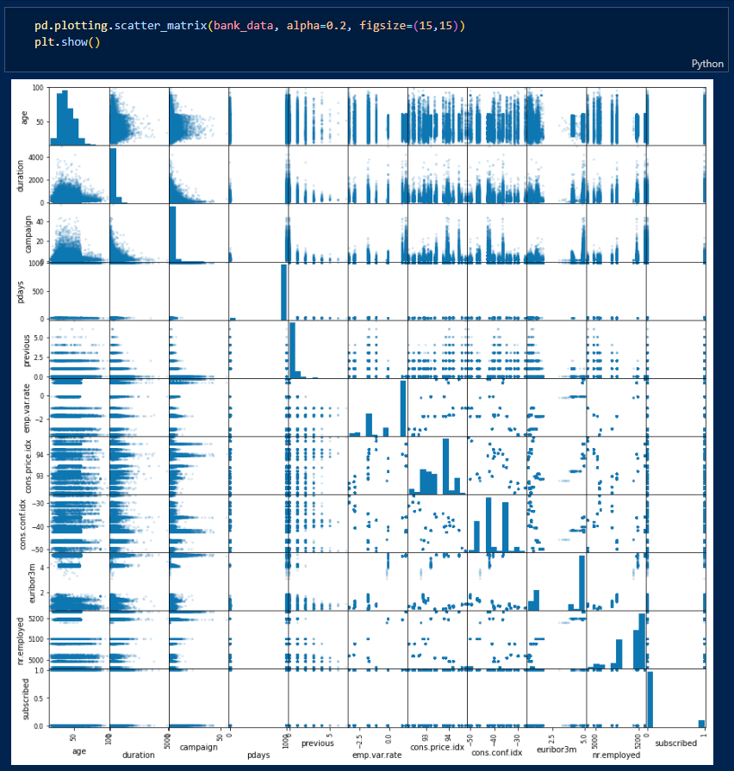

Slide 35
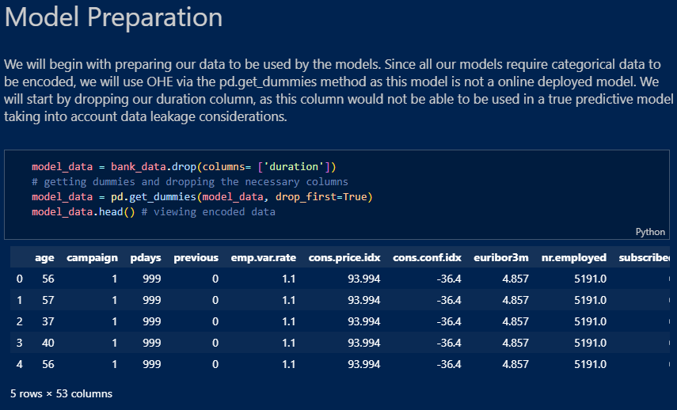

Slide 36
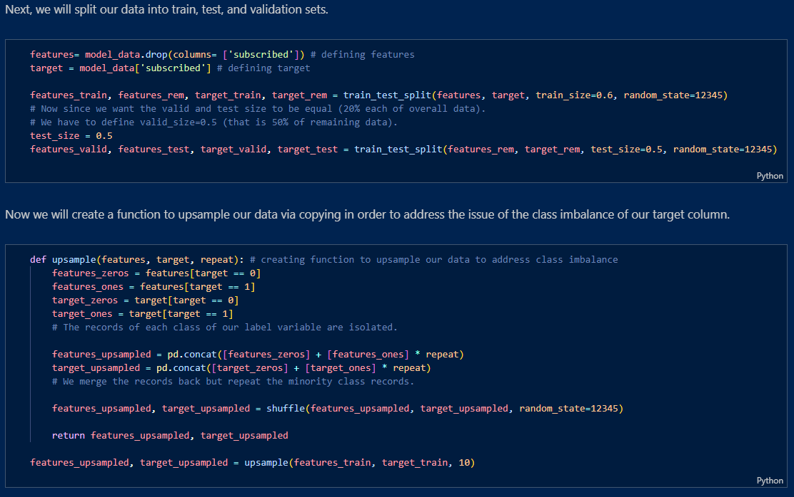

Slide 37
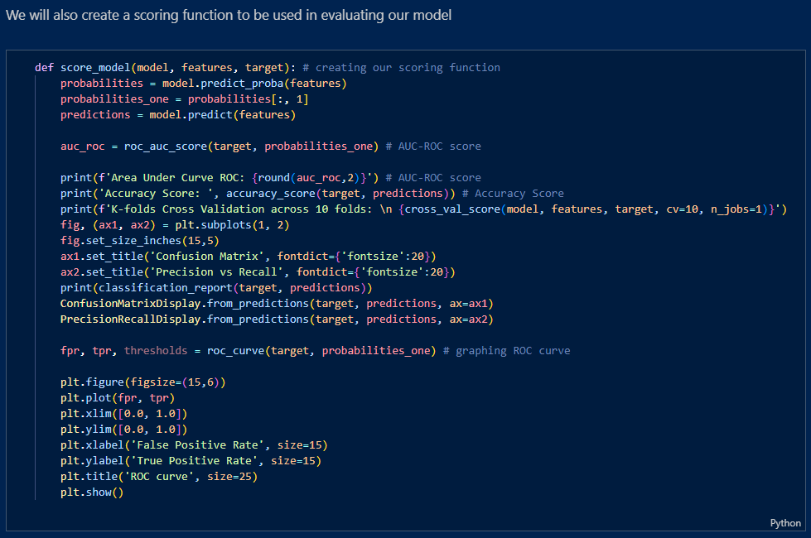

Slide 38
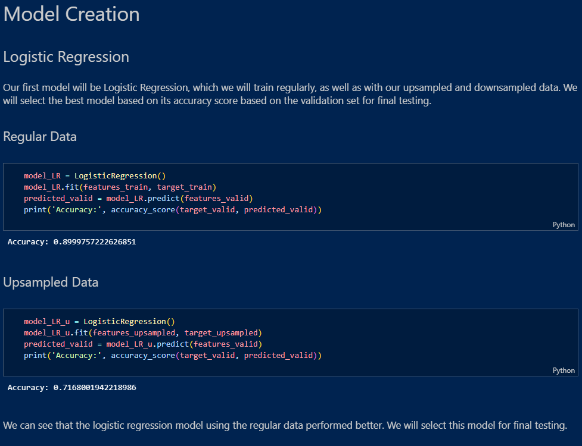

Slide 39
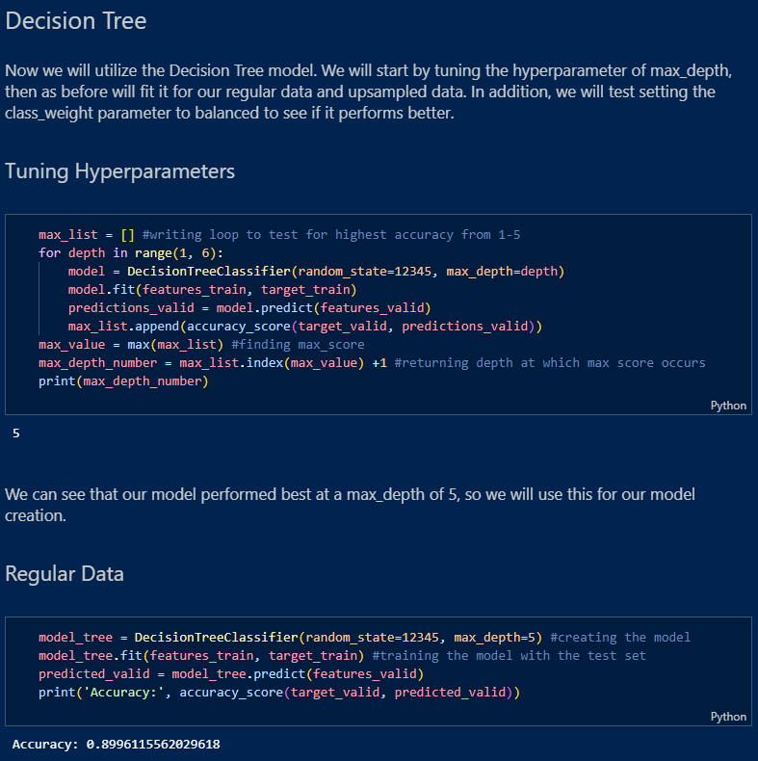

Slide 40
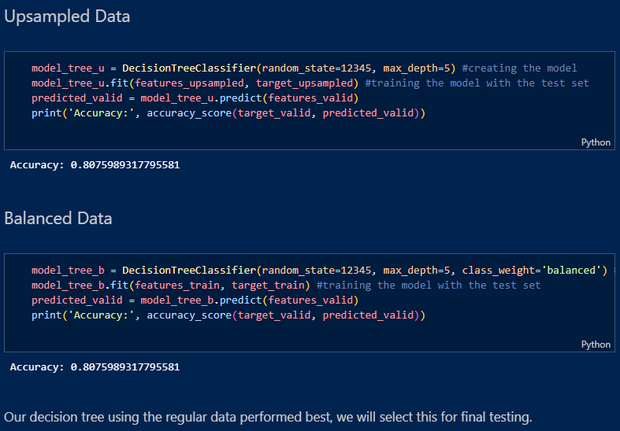

Slide 41
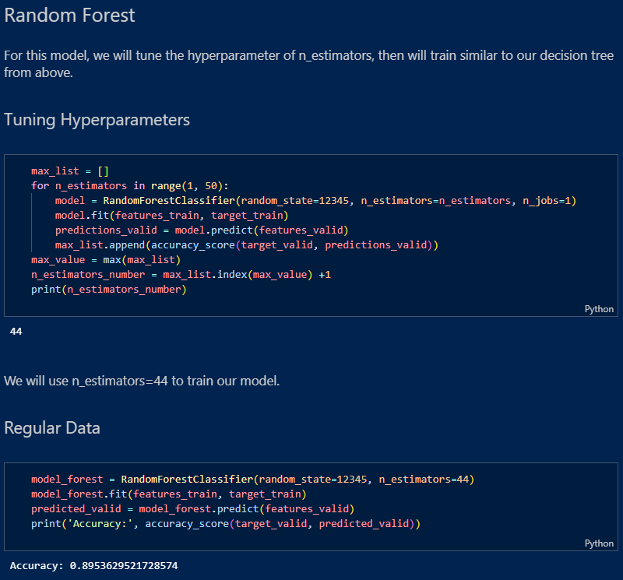

Slide 42
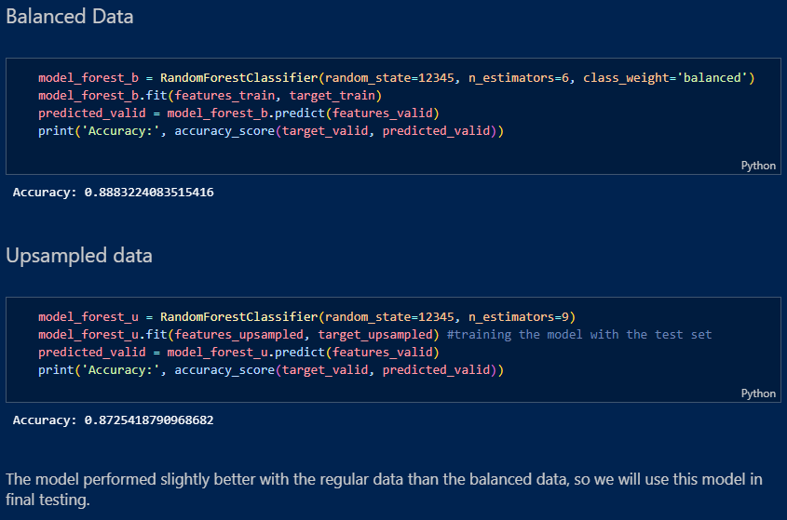

Slide 43
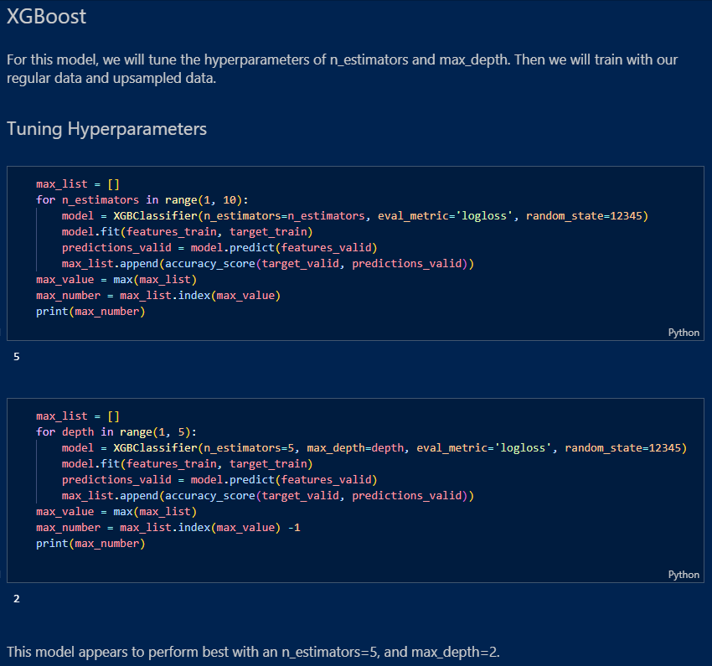

Slide 44
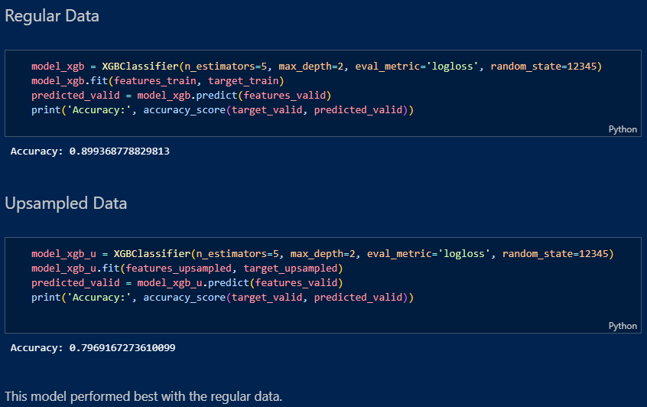

Slide 45
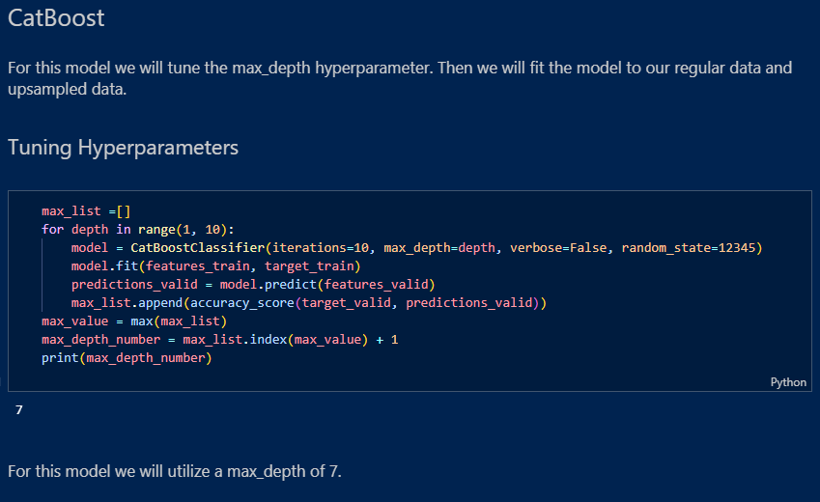

Slide 46
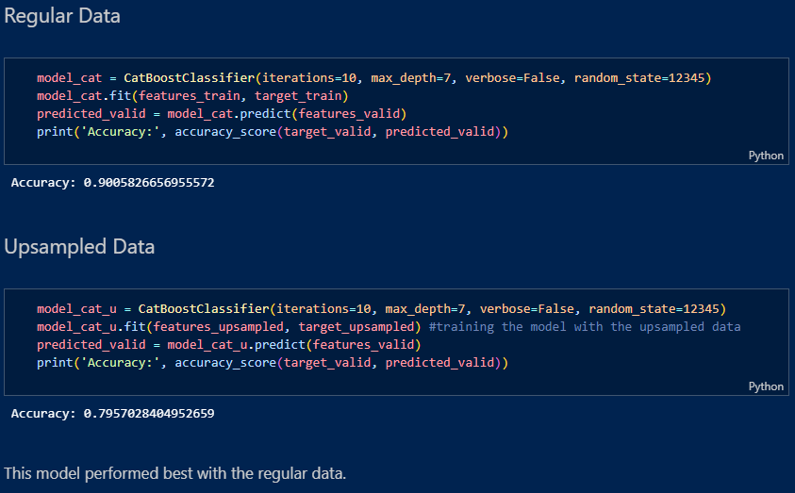

Slide 47
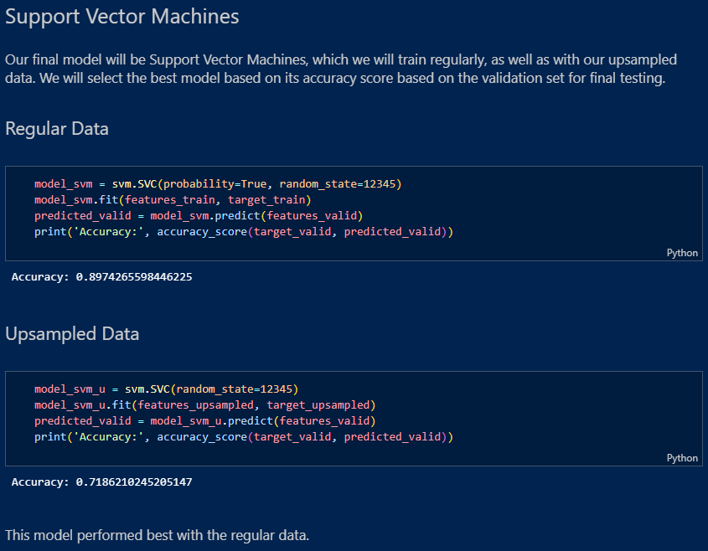

Slide 48
Model Testing
We will now move onto our final testing for each model we selected above. We will utilize our scoring model that we created which will give us the AUC-ROC score, accuracy score, classification report, confusion matrix, precision vs recall graph and show our ROC curve. We will compare our models and select the one which performs the best.

Slide 49
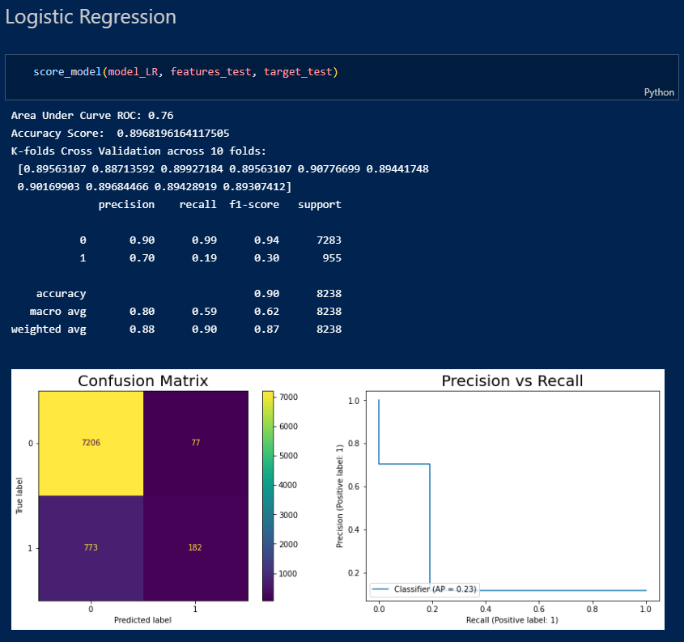

Slide 50
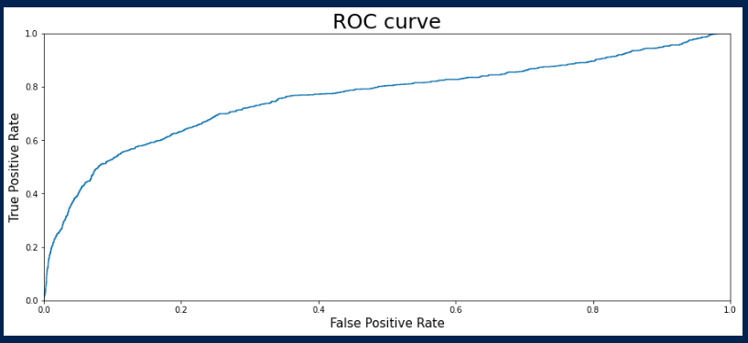

Slide 51
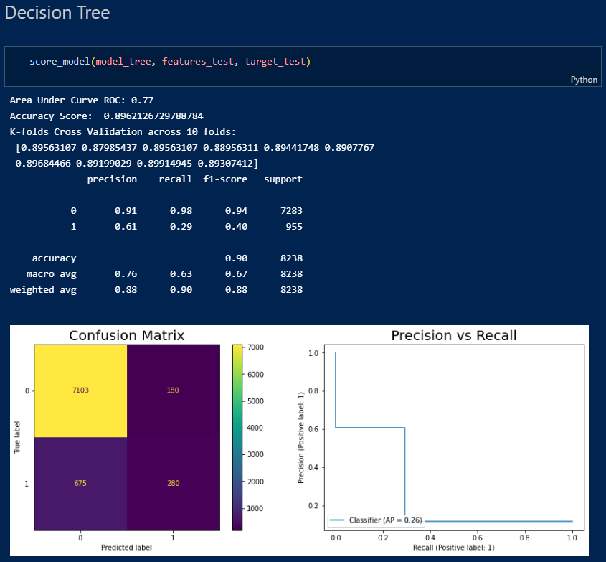

Slide 52
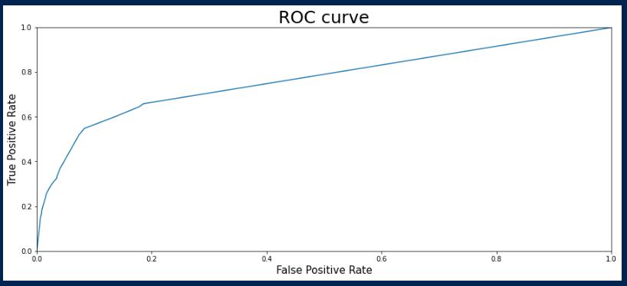

Slide 53
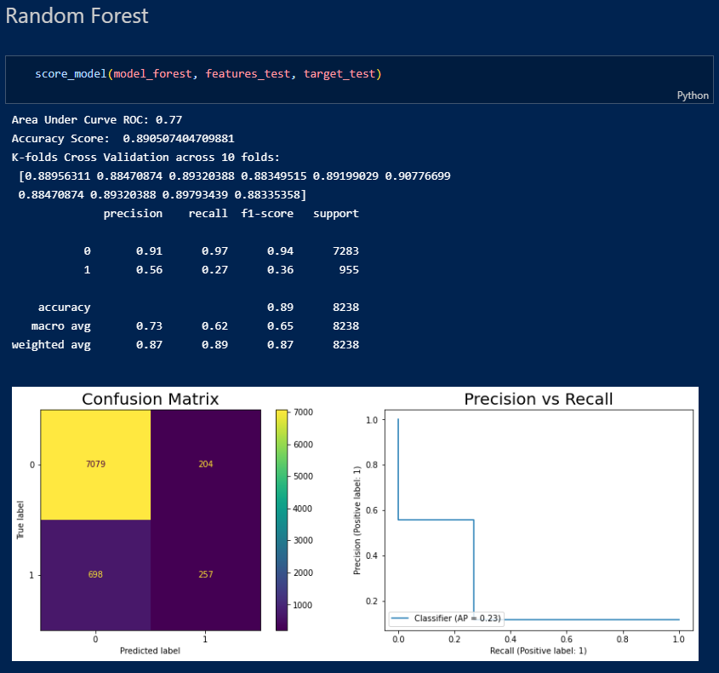

Slide 54


Slide 55


Slide 56


Slide 57


Slide 58


Slide 59


Slide 60


Slide 61
Final Steps
Overall, we have some models which have performed very well. The Logistic classifier was the most accurate but suffered in other metrics, such as recall. Because we want to maximize the number of conversions, recall should be prioritized over precision. Our CatBoost model performed the best, with an AUC-ROC score of 0.79 and accuracy score of 0.89. This is the model we will select to utilize for future marketing efforts to focus on those most likely to subscribe. We will try an advanced oversampling method called SMOTE(Synthetic Minority Oversampling Technique) in order to generate new data that is not merely a copy of other records.

Slide 62


Slide 63


